Slide 1
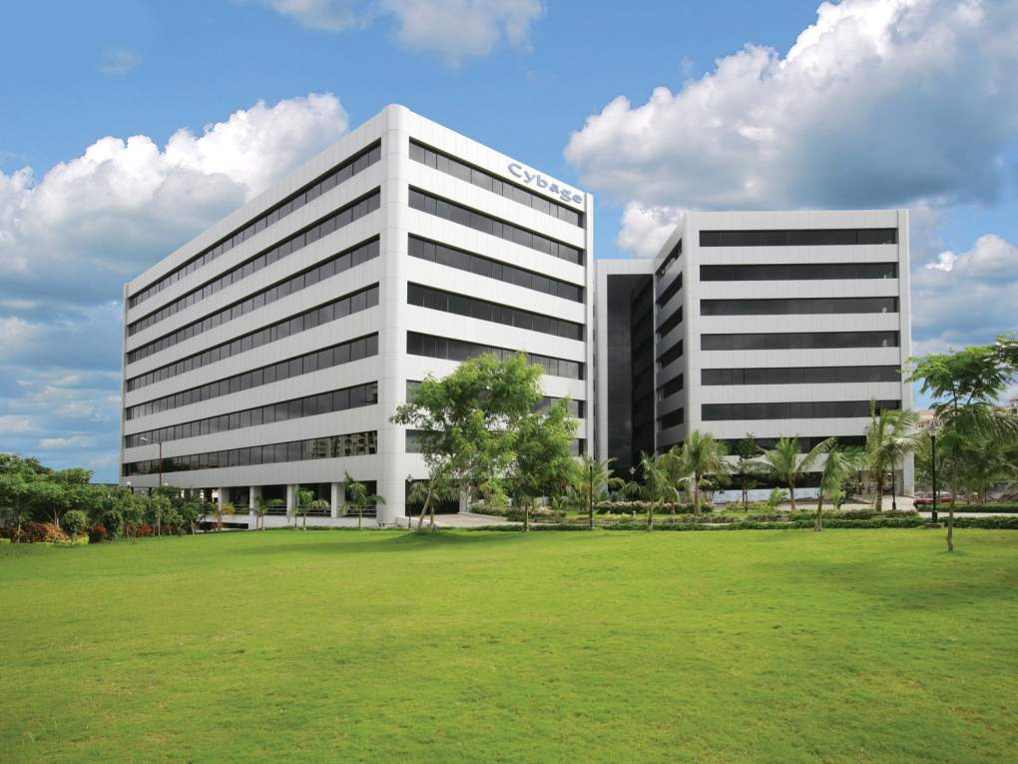

DevOps at Cybage

Slide 2
Agenda
Cybage ALM Vision
Benefits of ALM
Re-thinking IT
ALM & DevOps
What is DevOps ?
Challenges
Pain Areas for Dev and Ops
Business value
Value Addition
Keys to Enterprise DevOps
ALM: Technology Streams
Services(ALM and Devops)
Continuous Integration
Continuous Delivery
DevOps Simple Maturity Model
DevOps Practices
Infrastructure as Code
CI/CD Deployment Pipeline
Continuous Monitoring
ALM Tools Stack – Open Source & Microsoft
DevOps Ecosystem
Docker Ecosystem for DevOps
ALM Tools Integration (Microsoft)
Managing Distributed Systems
ALM implementation stages
Pattern of Success
ALM Team
Resource Competency
Case studies
Centralized Server – LT & MS

Slide 3



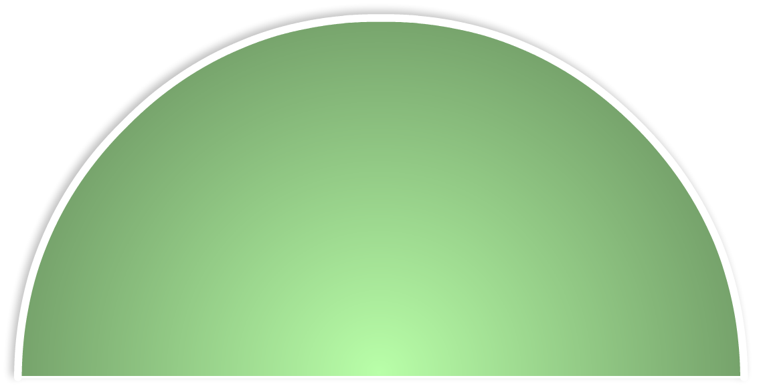



Cybage ALM Vision
• ALM objectives
• Governing
• During phases
• By strategising
• Beneficial to stakeholders
Organisation
Client
Project
Development
Design
Testing
Skills
Requirement
Analysis
Deployment
& Release
Process
ALM
Tools

Slide 4
Benefits of ALM
Efficiency
• Quality
• Productivity
• Speed
Transparency
• Team maturity
• Auditability
• Dashboard and reports
Collaboration
• Effective communication
• Distinct role and responsibility
• Reduced dependency
Visibility
• Traceability
• Predictability • Analytics
4

Slide 5
ALM: Technology streams
ALM streams
Microsoft technologies
Open-source technologies
TFS
VSTS
Atlassian tools
(On-premise and Cloud)
5

Slide 6
Our services (ALM)
Assessment of processes and practices
Consultancy to derive strategy and select tools & processes
End-to-end ALM solutions, implementation and training
Audits
6

Slide 7
Our services (DevOps)
Infrastructure as Code
Continuous Integration
Continuous Delivery and Deployment
Continuous Monitoring
Containerization
On-premise and Cloud-based solutions: AWS/Azure
7
Notes:
Tools
• VSTS ,TFS, PowerShell DSC, Application Insights
• Docker, Chef, Ansible, Mesos, Kubernetes, SysDig, Jenkins, Appveyor
• New Relic,Nagios, ELK

Slide 8
Re-thinking IT
Cycle time is the most important driver for IT today
DevOps
Microservices
IT
Cloud-based
Infrastructure
Continuous
Delivery

Slide 9
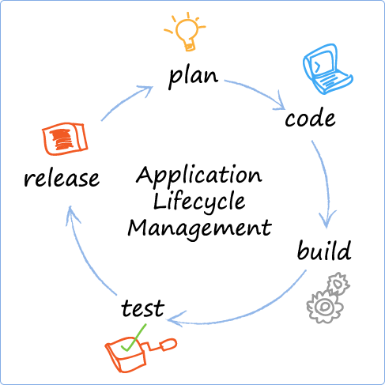
ALM & DevOps
ALM is a continuous process of managing the life cycle of an application right from initial planning till completion through governance, development, and maintenance.
DevOps is a set of practices to reduce time between committing a change to the system and production environment while ensuring high quality
DevOps

Slide 10
What is DevOps ?
Continuous assessment
Continuous integration
and testing
Continuous delivery and
deployment
Continuous operations
Test
Deploy
Continuous assessment
Key Benefits
Faster release of apps with automation of integrated build, Test and deployment process
Increase developer and operational efficiency by managing infrastructure as code
Improve customer experience with immediate feedback and continuous improvement
Better quality through solid integrated test practices

Slide 11
What is DevOps ?
Development
DevOps is a work culture
(Software Engineering)
Collaboration between Dev & Ops teams
DevOps
Shift from Waterfall -> Agile -> Lean
Operations
QA
(Quality Assurance)
Manual -> Automation

Slide 12
Challenges
Test, deploy & release take more time than design and build
Production incidents due to human errors in manual release
Development and Operations not in alignment

Slide 13
Pain Areas for Dev and Ops Teams
Dev, QA and Ops teams work in different environments
Overall Poor quality of development & operations
Manual builds, deployment & release process
Manual process of provisioning Environments
To Snapshot & version Environments
Downtime issues

Slide 14
Business value
Customer feedback
Quality of deliverables
Operational efficiency
Consistency & Scalability (w.r.t. Deployment)
Business revenue
Human-errors & dependency
Time for infrastructure setup, & maintenance
Time to application deployment
Time to market
Mean-time-to-resolution (MTTR) of production issues

Slide 15






Value Addition
All Environment Same, Easy to Snapshot of Environments | Automate everything (in pipelines)
Faster to create/manage Environments | Lower cost of Resource , storage & CPU by using Containers
Faster & more releases | Cohesive teams with shared objectives
Easy to build, test and deploy Apps | Zero downtime due to Auto rollback
Strong source control | Lean principles and continuous delivery of value
Zero manual build and deploy | Embrace failure, recover automatically, degrade gracefully
Test early and often | Elastic supply of cloud resources

Slide 16
Keys to Enterprise DevOps
Continuous
Integration &
Testing
Continuous Delivery & Deployment
Continuous Operations
Continuous Assessment
Increases developer productivity
Shortens development cycles with Agile
Operational efficiency by managing infrastructure as code
Improves customer/developer experience with immediate feedback loops

Slide 17
ALM: Technology streams
ALM streams
Microsoft technologies
Open-source technologies
TFS
VSTS
Atlassian tools
(On-premise and Cloud)
17

Slide 18
Our services (ALM)
Assessment of processes and practices
Consultancy to derive strategy and select tools & processes
End-to-end ALM solutions, implementation and training
Audits
18

Slide 19
Our services (DevOps)
Infrastructure as Code
Continuous Integration
Continuous Delivery and Deployment
Continuous Monitoring
Virtualization and containerization
On-premise and Cloud-based solutions: AWS/Azure
19
Notes:
Tools
• VSTS ,TFS, PowerShell DSC, Application Insights
• Docker, Chef, Ansible, Mesos, Kubernetes, SysDig, Jenkins, Appveyor
• New Relic,Nagios, ELK

Slide 20
Continuous Integration
Move fast and fail fast
Build management
5
Fail or Succeed
Compile
Run Unit tests
4
Publish reports
Run Integration tests
Target Server
Source Control Server
Package
3
Build
Build success
2
7
Fetch changes
Deployment
1
Check-in Changes
6
Notify success or failure
Developer 2
Developer 1
Manager

Slide 21
Continuous Delivery
Deploy Smaller Changes, More Frequently
Deploy
Deploy
Integration
Staging
Code check-ins
Functional test (Automated)
Continuous Monitoring
Code analysis
Unit test
Code coverage
Acceptance test
Performance test
SCM
Test
Production
Deploy
Continuous Delivery

Slide 22
DevOps Simple Maturity Model
Level # 0
Level # 0
Level # 1
Level # 2
Level # 3
Level # 4
Build
Manual Build
Build script
Scheduled
Build
Build on Commit Using CI server
Auto Build
on Commit
& Merge
Deploy
Manual
Deploy
Deployment
Script
Auto build
deploy to
Test env
Continuous Delivery with automated & manual test
Continuous
deployment
to production
Testing
Manual
Test
Partial
automated
tests
Automated Test during Build
Code coverage
Automated
functional
Tests during CI
Automated
Non
Functional
test

Slide 23
DevOps Practices
Infrastructure as a code
Continuous Integration (C.I.) & Continuous Delivery (C.D.)
Continuous Monitoring

Slide 24
Infrastructure as Code
Meaning infrastructure management using code or script encouraging automation
Environment creation
OS installation
Software installation
Configuration
On demand provisioning
Standardization of environments
Zero human-errors
Reduced cycle time & cost
Tools
Puppet, Chef, Ansible, Docker, AWS [CloudFormation, Terraform]
Windows PowerShell/DSC

Slide 25
CI/CD Deployment Pipeline
Extend C.I. to Staging & Production
Delivery Pipeline
Continuous Testing
Continuous Deployment
Improved quality
Faster time to market
Frequent feedback from customer
Tools
Git, Maven, Jenkins, Bamboo, Selenium, Chef
AWS – CodeCommit, CodeDeploy, CodePipeline
TFS Build, Microsoft Release, Octopus, Appveyor

Slide 26
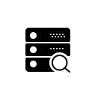

Continuous Monitoring
To monitor following on continuous basis and raise alerts
System (hardware)
Application
Log
Container
To check health of servers
To raise the alerts on failure
Infrastructure Monitoring
Physical /Virtual Machine CPU, RAM, Disks etc…
Services
Network
Tools
ELK
Nagios
Prometheus
cAdvisor
Ruxit
Pagerduty
Datadog
Sysdig
Application Monitoring
User load, Response time, Performance, Failures, Logs

Slide 27


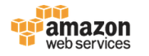
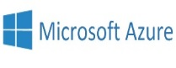



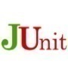
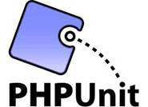







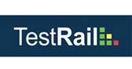

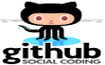





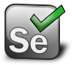
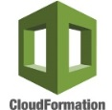
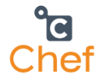
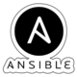
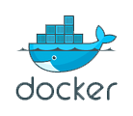
ALM Tools Stack – Open Source
Requirements management
Project
management
Architecture & Design
Cloud provider
Development
Testing
Development
Development
Test case management
Unit
testing
SCM
SCA
Continuous Integration
or
or
Build
CI server
or
Release management
or
Repository management
or
ANT
or
or
or
&
or
or
Automation
testing
DevOps
DevOps
Configuration management
Cloud provider
Containerization
Continuous Monitoring
or
or
ELK
Sysdig
cadvisor
Note: Solution offering for on-premise & on-cloud

Slide 28
ALM Tools Stack – Open Source
User Identity Management
Requirement Management
Project Management
Version Control System
Repository Manager
Crowd
Confluence
Jira
JiraAgile
SVN
Git
CVS
Bitbucket
GitHub
GitLab
Stash
TDD
Code Coverage Tool
Static Code Analysis
Build Tools
CI-CD Server
Junit
Mockitos
Clover
Jacoco
SonarQube
Ant
Maven
Gradle
Jenkins
Bamboo
Binary Repository Manager
Configuration Management
Test Case Management
Testing Automation
Load/Performance Testing
Artifactory
Nexus
Ansible
Chef
Puppet
Docker
Zephyr JIRA plugin
TestLink
Selenium
Zephyr
SoapUI
JMeter
Gatling
Cloud or VM
PAAS with Docker support
Continuous Monitoring
Vagrant
Vmware
VirtualBox
AWS - ECS
Mesosphere
Kubernetes
Rancher
ELK
Nagios
Sysdig

Slide 29
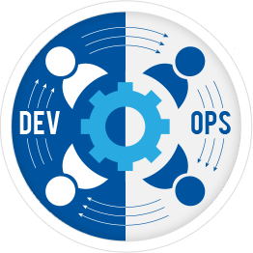
DevOps Ecosystem
Provisioning
Cloud Provisioning
Containers
AWS services
Chef
Puppet
Ansible
AWS CloudFormation
Terraform
Packer
Docker on Linux
Docker on Windows
CodeCommit
CodeBuild
CodeDeploy
CodePipeline
Orchestration
Public Cloud
Mesosphere
Kubernetes
Rancher
Swarm
AWS
Azure
Load-Balancer
Nginx
HAProxy
Alerts
Service discovery
Continuous monitoring
AWS Lambda
Pagerduty
CloudWatch by AWS
Slack
Consul
Etcd
Eureka
ELK/EFK
Sysdig
Nagios
Serverless framework
Claudia framework

Slide 30

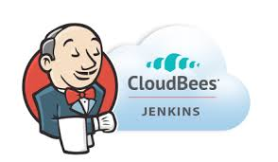


Docker Ecosystem for DevOps
Docker Tools
Orchestration
Image Scanning
Deployment
Compose
Swarm
Kubernetes
Mesosphere
Swarm
Twistlock
Aqua
Spinnaker
Jenkins
Registry
Docker on Cloud
Docker Hub
AWS ECR
Azure ACR
Quay
AWS ECS
Google GKE
Kubernetes SAAS
Stackpoint
Platform9
Networking
Metrics
Monitoring
Stateful
Weave
Calico
Prometheus
Grafana
Sysdig
Datadog
AWS EFS
GlusterFS
Competency in Cloud Based CI/CD Providers with Docker Support

Slide 31

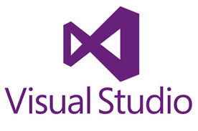

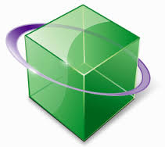
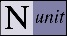


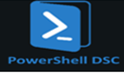
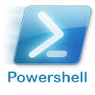
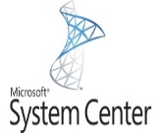


ALM Tools Integration (Microsoft)
Requirement Management
Project
Management
Architecture & Design
Cloud provider
Architecture & Design
Development
Testing
Unit
testing
SCM
SCA
Microsoft Test Manager
Continuous Integration
or
Build
CI server
or
or
MS Build
or
Automation
testing
or
or
Coded UI Test
Repository management
or
or
ANT
or
Continuous Delivery/Deployment using DevOps
Release
management
Configuration management
Containerization
Continuous Monitoring
or
Note: Solution offering for on-premise & on-cloud

Slide 32
Managing Distributed Systems/Microservices
Functions
Solutions
Configuration Management
Centralized Config Server
Service Registration & Discovery
Consul, etcd, Eureka, Zookeeper
Routing & Load Balancing
Nginx, Ribbon, AWS ELB & API Gateway
Distributed Tracing
Zipkin
Fault Tolerance (Circuit Breakers)
Hystrix
Scheduler & Orchestrator
AWS ECS, Mesos, Kubernetes, Docker Swarm
Monitoring, Alerting, Logging
ELK, Sysdig, Ruxit, Cloudwatch, PagerDuty, ELK
Deployment & Snapshot
Docker containers, AWS CodeDeploy
Datacenter OS & cluster manager
Mesos, Rancher

Slide 33
ALM implementation stages
Ownership: The ALM team
Handing over
ALM
Awareness
ALM
Gap Assessment
ALM
Solution Proposal
ALM
Implementation
Post-implementation Support
ALM presentation
ALM demo for stakeholders
Understand the workflow
Analyze gaps
Identify R&D or POC
Propose end-to-end solution with integration
Implementation
Training
Handholding
Sign-off
Audits (later)
Reports compilation
Support
33

Slide 34
Pattern of success
Maintain everything in version control
Continuous Integration
Automate (almost) everything
Keep batch sizes small
Move fast -&- fail fast
Fully integrated development and testing
34
Notes:
Tools
• VSTS ,TFS, PowerShell DSC, Application Insights
• Docker, Chef, Ansible, Mesos, Kubernetes, SysDig, Jenkins, Appveyor
• New Relic,Nagios, ELK

Slide 35
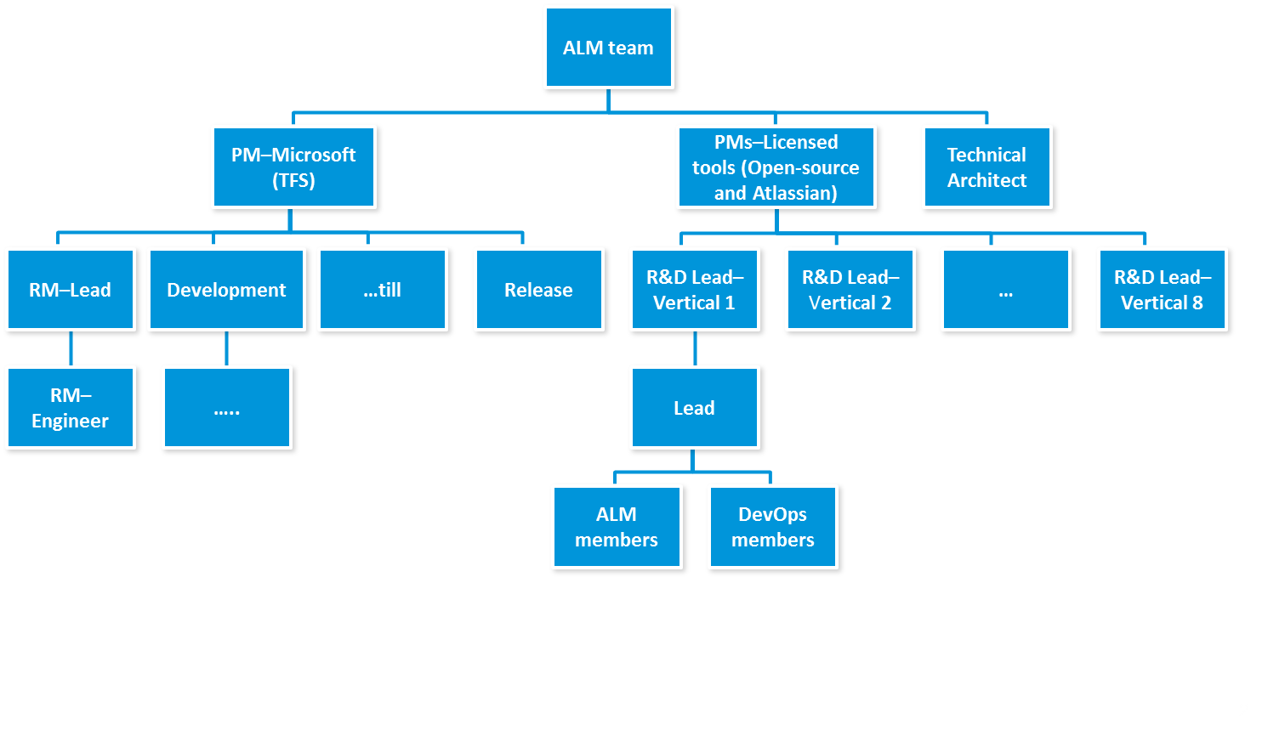
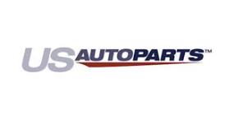
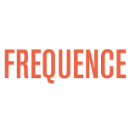





Statistics (Team Structure & Implementation)
80+
ALM experts
128
ALM implementations (Projects completed)
48
ALM implementations (Projects in-progress)

Slide 36
Resource competency
 | Java, Lamp, JS |  | Java | PHP | JS
General | CROWD (SSO), HipChat (communication)
Project Management | JIRA, JIRA Agile
Requirement Analysis | Confluence
Source Code Management | Git, SVN
Repository Management and code review | Bitbucket, FishEye-Crucible, GitHub, GitLab
Build process |  | Ant, Maven, Gradle |  | Ant, Phing, Grunt, Gulp | Grunt, Gulp
Unit testing |  | JUnit, TestNG, Mockito |  | PHPUnit | Mocha-chai
Code coverage | Emma | Cobertura, Clover, JaCoCo |  | Clover | Cobertura, Istanbul
Static Code Analysis | SonarQube | PMD, Checkstyle, FindBugs |  | PHPMD, PHPCPD, PHPCS | JSHint, JSLint
36

Slide 37
Resource competency (contd.)
 | Java, Lamp, JS |  | Java |  | PHP | JS
Test-case management | Zephyr, Zephyr JIRA, TestLink
CI server | Jenkins, Bamboo
Binary repository manager | Nexus, Artifactory
UI testing |  | Selenium |  |  |  | NightWatch
Stress testing | JMeter, Gatling
Configuration management | Chef, Puppet, Ansible, SaltStack
DevOps | AWS CodeCommit, AWS CodeDeploy, AWS CodePipeline, AWS ECS, Codeship with AWS, CloudBees Jenkins Enterprise, Vagrant, DigitalOcean, JIRA-ServiceDesk, GlusterFS, Kafka, HAProxy, Bunyan
Profiling |  | JProfiler |  | Xdebug, Blackfire
Continuous Monitoring | ELK, Nagios, New Relic
37

Slide 38
1: CI and CD Implementation - Jenkins & Docker
Project overview
DevOps Tools
Migrating current application to Nodejs and Angularjs platform
Implemented CI, CD and DevOps practices using Docker containers for build, test & deployment automation
GitLab, Git
Jenkins
Grunt
Npm
Nightwatch-js
Mocha-chai
Istanbul
JSHint, JSLint, Sonar
Docker and DockerHub
Primary Business Challenges
Development, Build, QA - environments are created manually, no certainty of identical environments
The manual build process taking lot of time to get all the source code integrated & tested properly with manual unit testing and functional testing.
Getting correct dependencies for building Application takes lot of time and prone to human error.
Quality gates & early feedback is missing to check the quality of code in automated way.
Missing backward &forward Traceability between Requirements, Code commits, Build, etc.
Solution
Automated provisioning of all Environments and Automation of CI/CD process using Docker Images makes environments identical.
On every code Commit, automatically trigger Build process - Unit tests, Code quality checking tools - Sonar, JSHint and on every commit and release, the Artifacts – Docker image is automatically versioned and stored in DockerHub.
QA Environments created by using Docker is used by QA team for Manual testing and running automated UI testing.

Slide 39
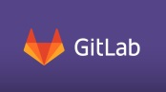

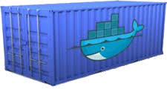

1: CI and CD Implementation - Jenkins & Docker
Fetch Dependencies
Docker Push
Pass?
CI Environment
Docker Push
Push
Docker Push
Pass?
Docker Push
Pull
Front End
Back End
QA

Slide 40
2: Continuous Integration & Auto deployment
Project overview
DevOps Tools
Implement Application Lifecycle Management best practices for the client
Atlassian Confluence
Atlassian JIRA
Git
GitHub
Jenkins
Maven
SonarQube
Atlassian Zephyr
Primary Business Challenges
Project Management:
JIRA and confluence integration was missing.
Repository Management :
Standard Git branching strategy was missing.
Static Code Analysis :
SonarQube was not integrated with Jenkins.
Minimum code coverage, Quality gate were not configured.
Continuous Integration and Build Process :
Jenkins was not integrated with JIRA.
Unit testing, Code coverage and SCA was missing during CI process.
Master slave architecture was missing.
Solution
Incorporate end-to-end traceability
Setup GitHub and Jenkins Integration.
Setup JIRA and Jenkins Integration.
Setup and Implement SonarQube and Integration with other tools.
Implement Client side hooks on developers end

Slide 41
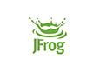

2: Continuous Integration & Auto deployment
EC2
I & T
I & T
I & T
Compile
I & T
I & T
Unit test
I & T
Code Fetch
Cobertura Code Coverage
Static Code analysis
Push Code
Weblogic
Package
.Ear Deployment on Weblogic
I & T
Integration & Traceability
Cybage End
Existing System
Proposed Solution

Slide 42
3: Continuous Integration and Deployment - Java
Project overview
DevOps Tools
Implement Application Lifecycle Management best practices for the client
Atlassian Confluence
CVS
Atlassian Jira and Jira Agile
SVN, Stash and Git
Jenkins
Ant/Maven
SonarQube
TestRail
Selenium using Testrail API
Active Directory
PostgreSQL, MongoDB, Infobright, MySQL, Datasource, CouchDB
Primary Business Challenges
Requirements Management (Confluence)
Project Management (JIRA and JIRA AGILE)
Static Code Analysis (SonarQube at Cybage end) and Continuous Integration
Unit Testing and Code Coverage
Integration and Traceability
Solution
Phase 1:
JIRA – SVN integration
Phase 2: Post discussions with Client
ELK Implementation
Jenkins permission configurations through Active Directory
Phase 3: Dependency on the ongoing configurations setup at the client end
Flyway
SonarQube
Junit
Clover

Slide 43
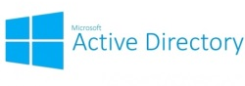


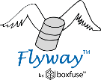




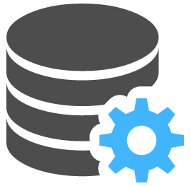
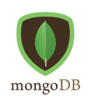

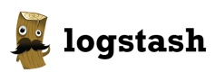
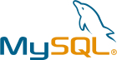



3: Continuous Integration and Deployment - Java
User Management Tool
Version Control Tool
Repository Management
C I Server
Static code Analysis
Requirement Management
Project Management Tool
Build tool
Binary Repository
Test Management
Unit testing
Code Coverage
Database Migration
Automation Testing
Application Server
Database
Database
Continuous Monitoring Tool
+
+

Slide 44
4. Microservices, AWS & Docker
Project overview
DevOps Tools
Migrating current application from Monolithic to Microservices Architecture
Confluence, JIRA
Git, Bitbucket
Jenkins, Sonar
Docker
AWS Cloudformation
AWS ECR
AWS Elastic Container Service
AWS ALB
Sysdig
ELK
Primary Business Challenges
Current Sprint release cycle was 3 months
Manual - build and deployment processes
Dev, Build, QA - environments created manually and were different
Quality gates & early feedback for Developers was missing
Missing backward & forward traceability between requirements, commits, build, etc
Meeting Non-functional requirements was a pain area and involved manual tasks
Solution
Immutable Infrastructure
Automated the CI/CD pipeline
On every commit, automatically trigger Build process - Unit testing, Code analysis, Package new Artifact (Docker image), store and version Artifact in Docker Repo
Automated deployment to Dev and QA environments
Faster deployments and high frequency of Deploys with Zero downtime
Infra as Code - Automated provisioning of all Environments
Dev, QA and Ops teams used the Same Docker image to create Environments
Using Orchestration service, we met NFR - HA, Auto scalability, Auto healing
Centralized log store and analytics
Continuous monitoring of Hosts, Containers and Applications

Slide 45
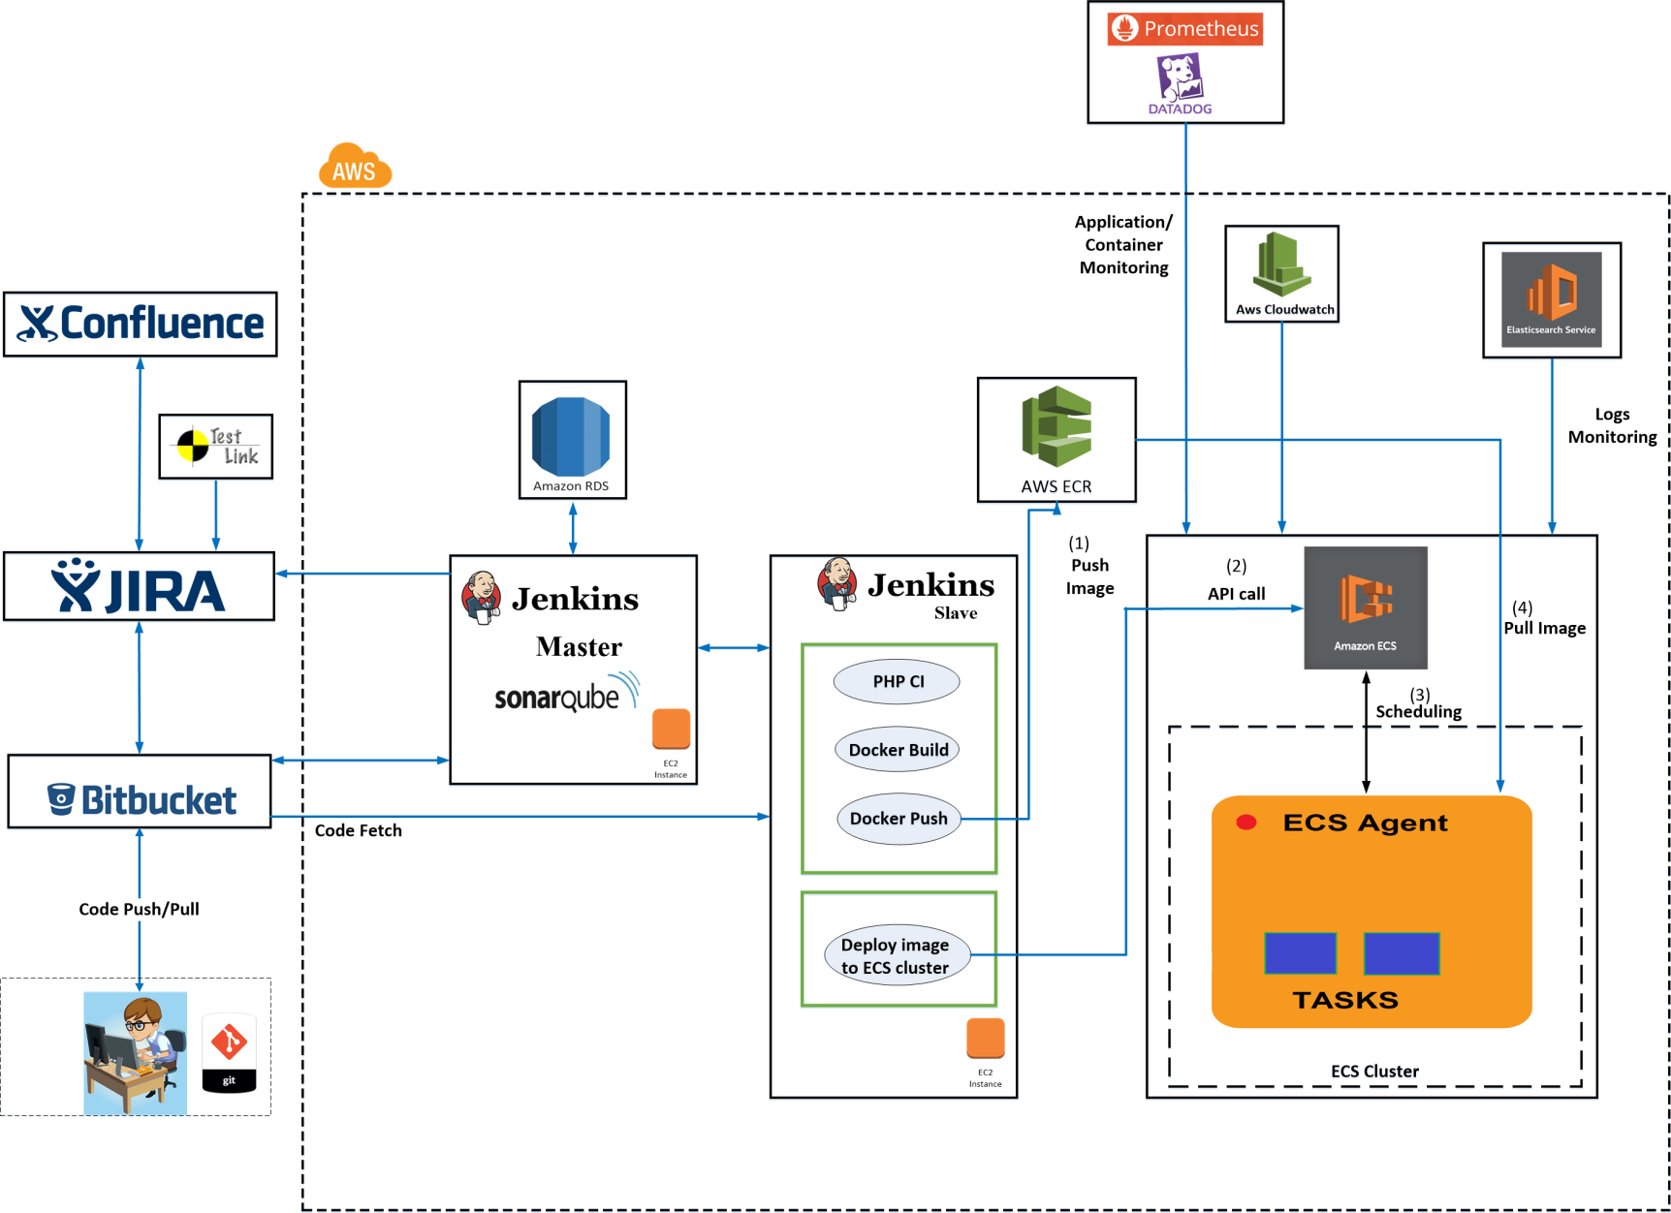
Case Study – Microservices, AWS & Docker

Slide 46
Centralized Server – LT & MS
Value add services offered by Cybage.
Open Source - LT
Centralized Server, list of tools configured:
Atlassian JIRA / JIRA Agile
Zephyr for JIRA
Zapi for JIRA
Atlassian BitBucket
Atlassian Crowd
Atlassian Confluence
Atlassian Fisheye and Crucible
SonarQube
Atlassian Bamboo / Jenkins
Additional secured layer (Uniken) allowing access to customer.
Microsoft - TFS
100+ projects active on Centralized server.
Best practice documents available on intranet for all the Cybagians.

Slide 47
Thank you!

